Slide 1
Geography of North Carolina

Slide 2
Five Themes of Geography
Location
Place
Region
Movement
Human Environment Interaction

Slide 4
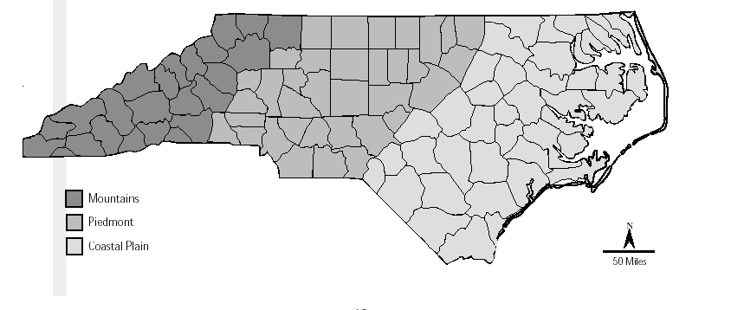
Regions of N.C.
Mountains
Piedmont
Coastal Plains

Slide 5
North Carolina
3 Regions Land
Coastal Plains
Piedmont
Mountains
Climate Resources

Slide 6
North Carolina ranks 28th among the 50 states in size!
60% of North Carolina is covered by forest!

Slide 7
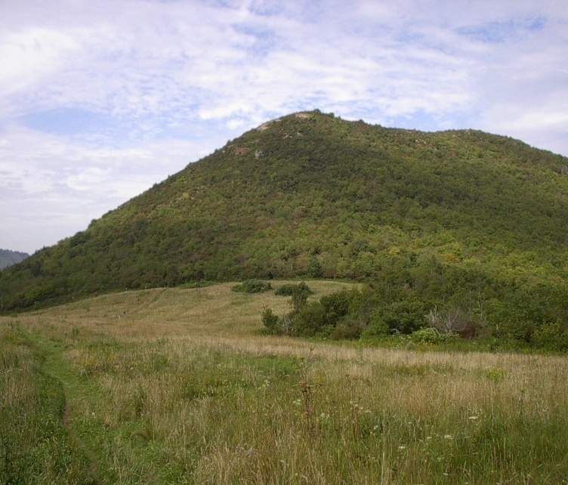
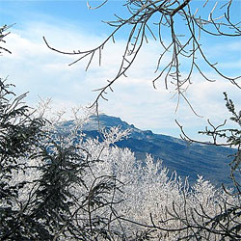
Climate and Weather of N.C.
N.C. has warm, humid summers and cool, damp winters!

Slide 8
Geography Notes
Outer Banks
Coastal
Plain
Tidewater
Piedmont
Climate
Long chain of sandbars and islands off the coast of North Carolina.
Broad, flat region in North Carolina that stretches 100 to 150 miles inland from the Ocean.
Low-lying eastern part of North Carolina’s Coastal Plain.
Hilly region between the Coastal Plain and the Appalachian Mountains.
The main kind of weather that a region experiences over an extended period.

Slide 9
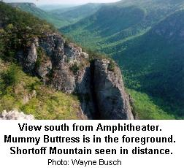
Natural Resources of N.C.
North Carolina has over 300 different kinds of rocks!
The dogwood is the state flower!

Slide 10
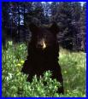
Wildlife of N.C.
Black Bears
Opossums
Wildcats
Deer
Rabbits
Birds

Slide 11
Water
The Atlantic Ocean borders North Carolina to the east.
N.C. has the Cape Fear River, Pee Dee River, Neuse River and Roanoke Rivers.

