Slide 1
The Founding of Jamestown
Chapter 5 Section 1

Slide 2
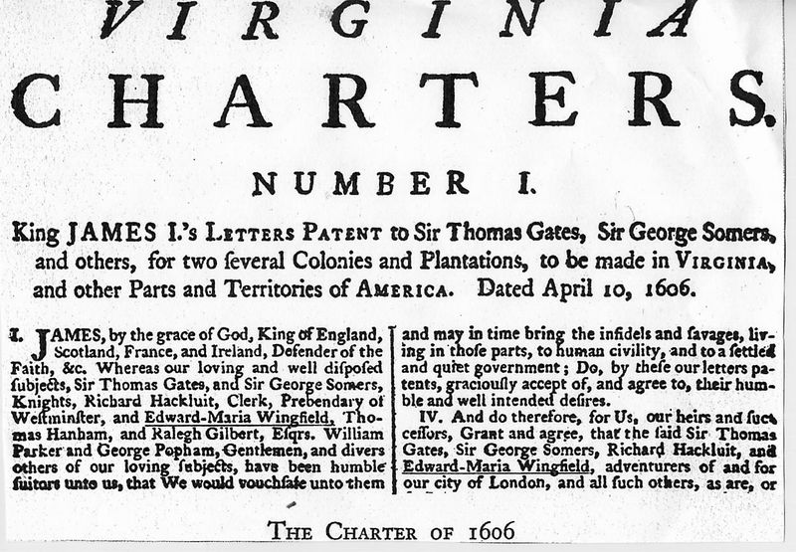
England Tries Again
King James I Grants the Virginia Company a charter to build a colony in Virginia.
Their main goal was to make a profit from the gold and natural resources they would find.

Slide 3
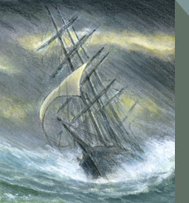
Journey to Jamestown
Ships were very small with very little personal space.
Journey took almost 3 months and was very difficult.
  Boredom, seasickness, and little food.
  Hard Tack
Why would people be willing to leave everything behind to make such a dangerous journey?

Slide 4
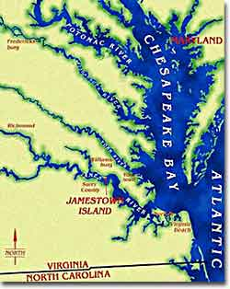
Jamestown is Settled
The expedition enters the Chesapeake Bay and sails up a river they called the James River.
They find a piece of land they believe is suitable for a colony and name it Jamestown.
  Fresh water
  Hidden from Spanish ships
  Could be easy reached by supply ships

Slide 5
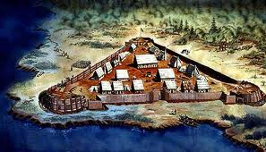
Trouble in Jamestown
Jamestown was built on a swamp.
  Many people got sick from drinking impure water.
  Mosquitos spread disease
Many colonists lacked survival skills.
  More interested in finding gold than farming.
Colonists are attacked by Natives who resent their arrival.

Slide 7
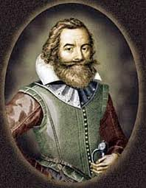
Strong Leadership Emerges
John Smith creates the Forced Work Program
  Smith also helps to improve relations with the Natives and began trading with them
  “He that will not work, will not eat.”
  Conditions improve
John Smith returns to England after being injured in a gunpowder explosion
  Colony begins to fail

Slide 8
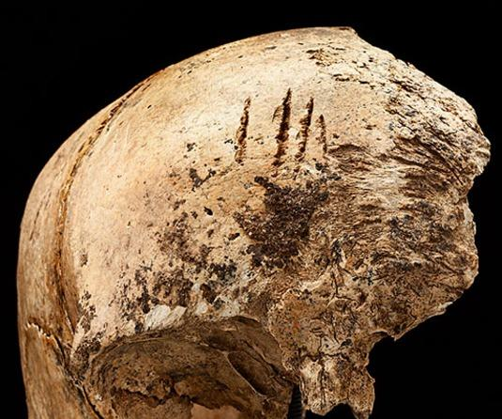
The Starving Time
The Virginia Company continues to send more people to Jamestown
  They do not bring food or supplies.
As winter approaches, food becomes scarce and people begin to starve.
Colonists eat whatever they can find to survive.
  Dogs, Cats, Rats, Shoes and even people.
  Only 65/500 colonists survive the winter.

Slide 9
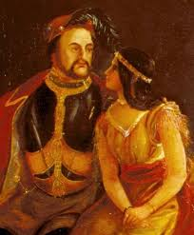
Conditions Improve
The remaining colonists attempt to Abandon Jamestown.
  Lord De La Warr arrives with supplies and restored leadership.
Pocahontas, the daughter of the Powhatan chief, is kidnapped and lives in Jamestown.
  Meets a farmer named John Rolfe and they get married.
  Relations with the Natives improve.

Slide 10
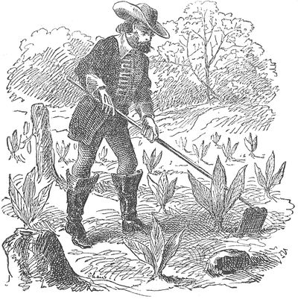
Trade in Tobacco
Tobacco becomes a valuable cash crop after it is brought to England from Roanoke Island.
John Rolfe plants the first tobacco plants in Jamestown.
  The first tobacco plant is worth over $1 million in todays money!
Soon everyone begins growing tobacco.

Slide 11
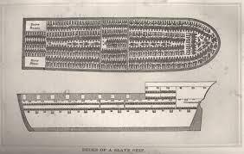
First Africans Arrive in Jamestown
As a result increase in tobacco farms, the demand for labor also increased.
Africans are sent to Jamestown as Indentured servants.
  They agree to work for 7 years in return for passage to the colony, food, clothes and 50 acres of land.
Many are never given freedom and are instead treated like slaves.

Slide 12
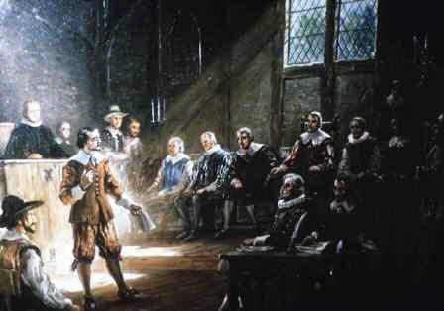
The House of Burgesses
As Jamestown grew, they were allowed to elect their own officials.
In each of the 11 settlements, colonists chose two men to represent them.
  Becomes the House of Burgesses.
Considered one of the first forms of government in the United States.

