Slide 1
English Attempts to Colonize North Carolina
Chapter 4

Slide 2
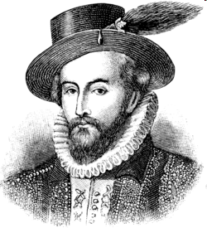
Early English Colonies
The English were not interested in finding a route to Asia.
Saw the New World as a place to attack Spain and start new colonies.
Queen Elizabeth I grants Sir Walter Raleigh a charter.
Gives him permission to explore, settle, and govern lands.

Slide 3
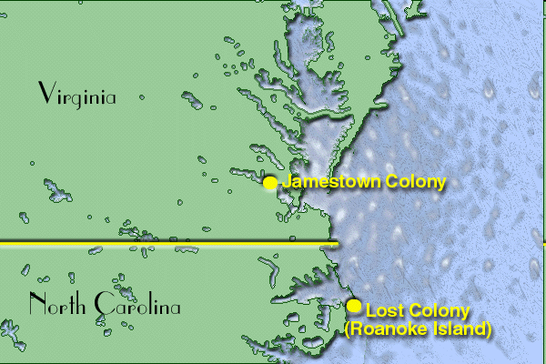
Amadas and Barlowe
Raleigh sends a small fleet to find the best location for a colony.
Amadas and Barlowe lead expedition.
They believe that Roanoke is the best place for an English colony.

Slide 4
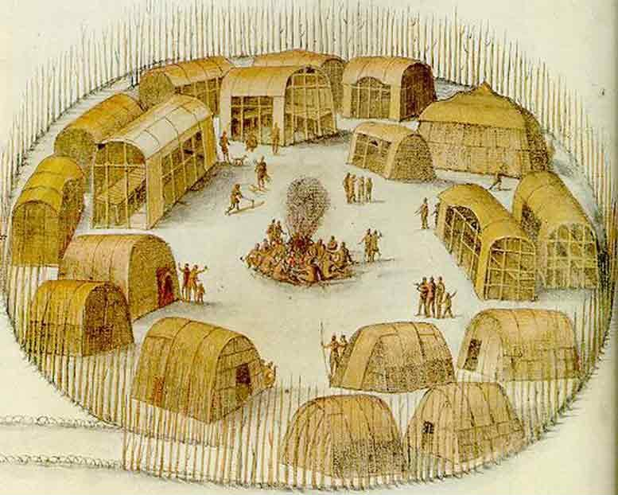
Ralph Lane Colony
Raleigh sends another fleet to Roanoke Island with the goal of establishing a permanent settlement.
Richard Grenville leads a fleet of 107 men to establish a colony on Roanoke Island.
Ralph Lane will lead the colony once they land.

Slide 5
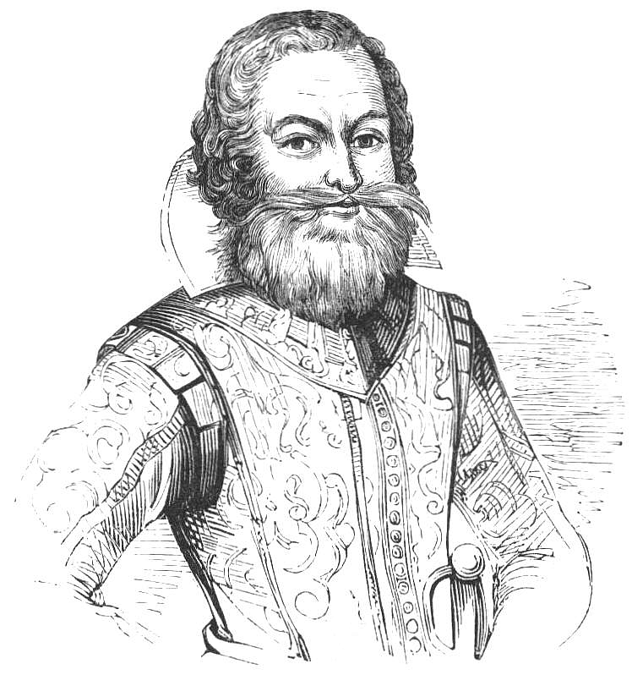
Difficulties Faced at Roanoke Island
One of the ships crashed on the shores of the Outer Banks.
Much of the supplies are destroyed.
Grenville returns to England to get supplies.
Colonists had arrived too late to plant crops.
Ralph Lanes leadership.
Militaristic leader.
Caused tension between Colonists and Natives.

Slide 6
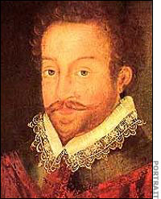
Abandoning the Colony
While awaiting Grenville’s return, Sir Francis Drake arrives and brings the colonists back to England.
Grenville arrives days later with the supplies, but learns that the colonists had already left.

Slide 7
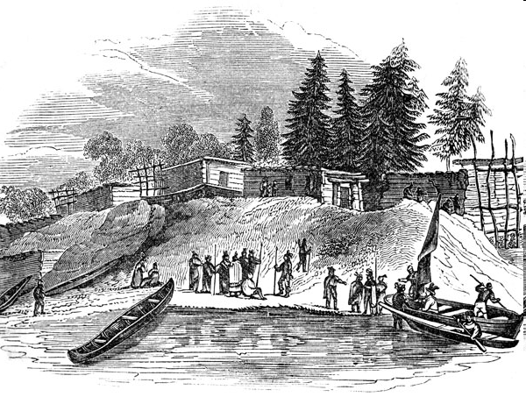
The Lost Colony
Raleigh sends another group of settlers led by John White.
Includes women and children.
The colonists arrive too late too late to plant crops…Again!
John White is forced to return to England to get supplies.

Slide 8
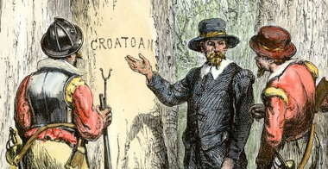
John White Returns
After 3 years, John White returns to Roanoke Island.
England was fighting a war with Spain.
When he returns, the colony is deserted.
The only clue he can find is the word CROATOAN carved on a tree and a post.

Slide 9
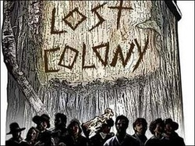
John White attempts to look for the colonists, but they have never been seen again.
There are many theories as to what happened to them, but no one knows for sure.
What do you think happened to them?

