Slide 1
Westward Expansion
Chapter 13

Slide 2
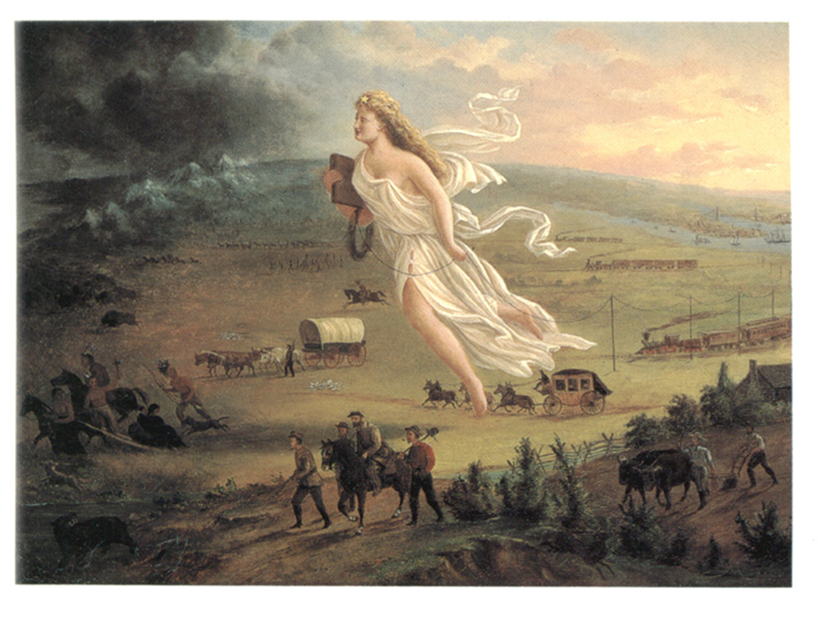
List everything you see in this picture.
Describe what is happening in the picture.
What do you think this picture represents? What led you to that hypothesis?

Slide 3
Manifest Destiny
The belief that it was America’s mission to expand from ocean to ocean, spreading democracy and freedom.
Americans believed it was their God-given duty to conquer the Western territories and unify the Nation.

Slide 4
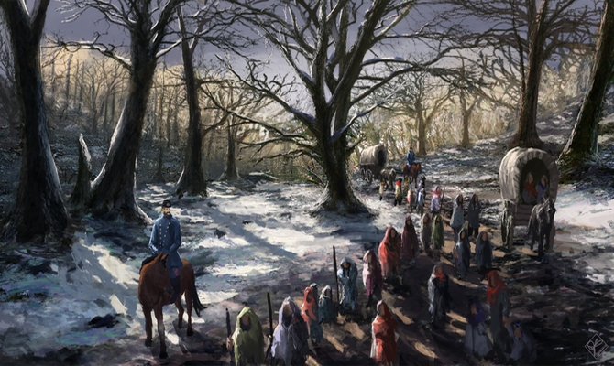
Trail of Tears
President Andrew Jackson signs the Indian Removal Act which required all Native Americans to relocate west of the Mississippi River.
Thousands of Cherokees were forcefully removed from their homes and forced to walk from Georgia to Oklahoma.
1/4 of the natives died.

Slide 5
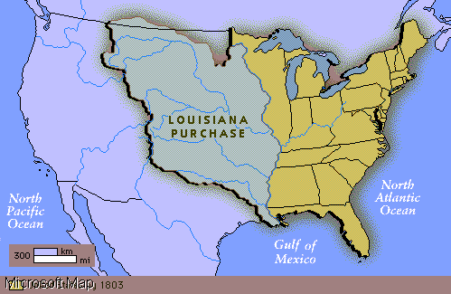
The Louisiana Purchase
Land purchased from France in 1803 by Thomas Jefferson for $15 Million.
Doubled the size of the U.S. and gave the U.S control of the Mississippi River.
Lewis and Clark were sent to explore this new land.

Slide 6
Florida
In 1817, General Andrew Jackson fought with the Seminoles into Florida against the presidents orders.
Demanded that Spain give the land to the U.S.
They sign the Adams-Onis Treaty which gave Florida to the U.S.

Slide 7
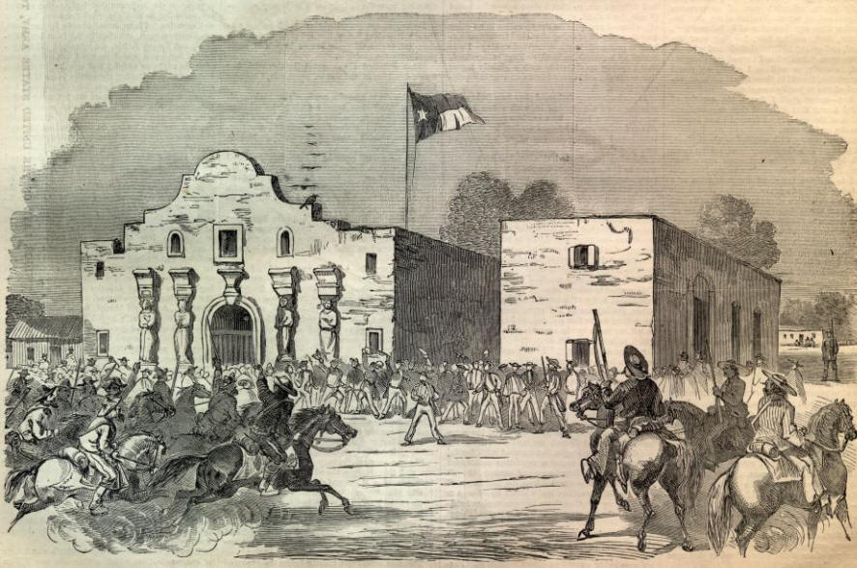
The Annexation of Texas
The Mexican government agreed to allow American settlers to move into Texas as long as they followed Mexican laws.
Soon, American settlers swarmed into Texas and outnumbered Mexicans 6:1.
Tensions began to rise and many settlers demanded independence from Mexico.
Many Texans are killed by Mexican soldiers at the Battle of the Alamo.
Texas gains independence soon after.

Slide 8
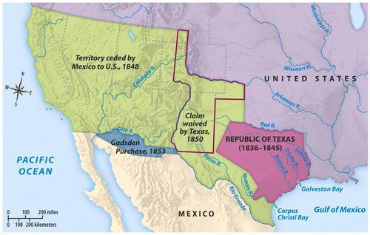
War with Mexico
Texas is admitted as a slave state in 1845.
Mexico still claimed Texas as its own.
War is declared in 1846 and the war lasts until 1848.
The treat of Guadalupe-Hidalgo ends the war.
Texas is recognized as part of the U.S.
U.S. gains the Mexican Cession

Slide 9
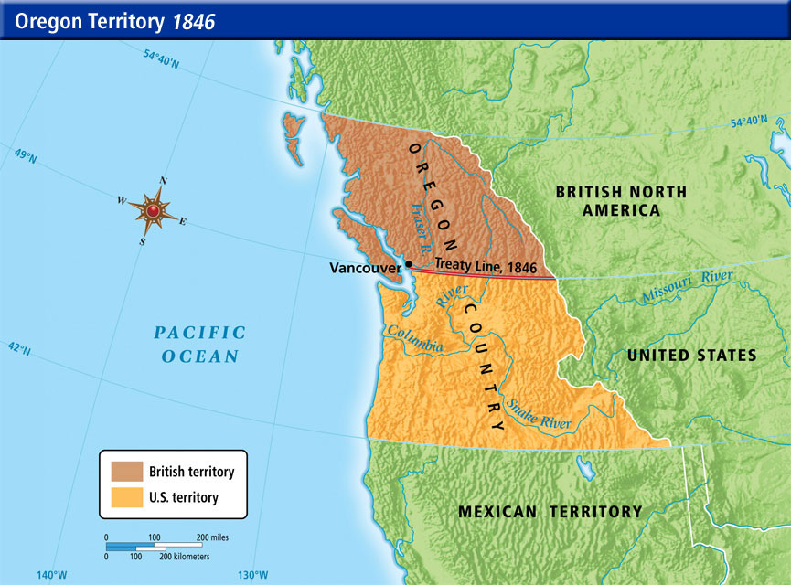
The Oregon Territory
Thousands of Americans had moved into the Oregon Territory, which they shared with Britain.
President James K. Polk wanted to take over the territory.
“Fifty-four forty or fight!”
The U.S. and Britain agreed to split the territory at the 49th parallel.

